Slide 1
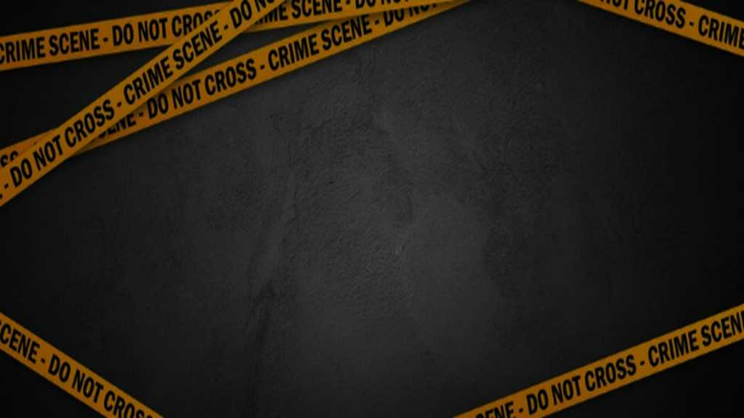
Crime and its types
Ms. Kauser Malik
Lecturer (Psychology)
Sciences and Humanities

Slide 2
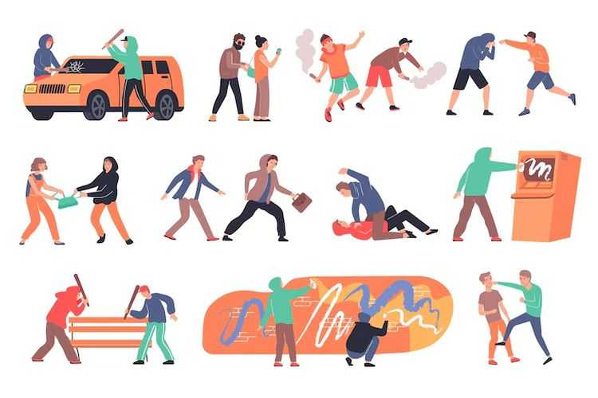
One category of deviance is crime, the violation of a society’s formally enacted criminal law.
Even criminal deviance spans a wide range, from minor traffic violations to prostitution, sexual assault, and murder.
Crime is the violation of criminal laws enacted by a locality, a state, or the federal government. Crime is a behavior that violates official law and is punishable through formal sanctions.
All crimes are composed of two elements: the act itself (or in some cases, the failure to do what the law requires) and criminal intent. Crimes are classified as one of two types based on their severity.

Slide 3
Types of Crimes

Slide 4
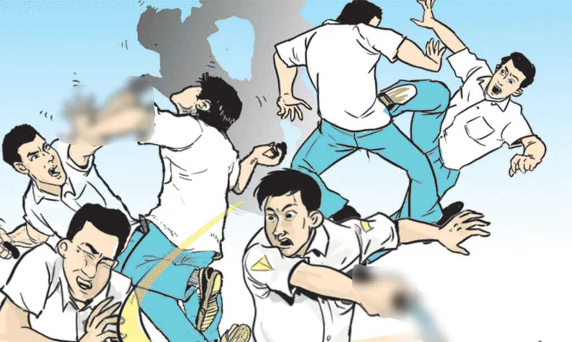
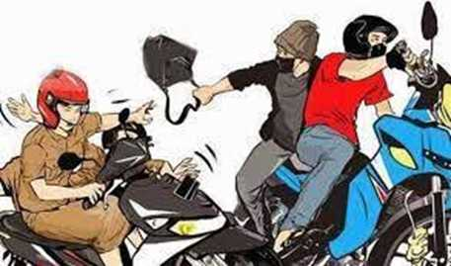
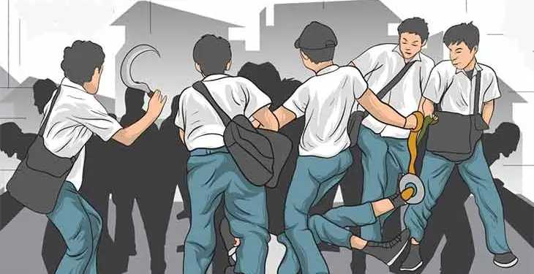
Violent Crimes
Also known as “crimes against a person, are based on the use of force or the threat of force. Crimes that direct violence or the threat of violence against others.
Include murders and manslaughter (legally defined as “the willful killing of one human being by another”), aggravated assault (“an unlawful attack by one person upon another for the purpose of inflicting severe or aggravated bodily injury”), rape (“penetration without the consent of the victim”), and robbery (“taking or attempting to take anything of value from the care, custody, or control of a person or persons by force or threat of force or violence and/or putting the victim in fear”).

Slide 5
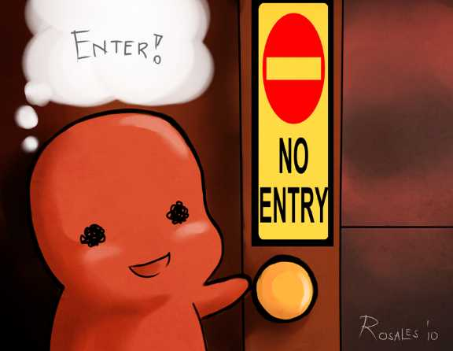
Nonviolent crimes
Involves the destruction or theft of property but do not use force or the threat of force. Crimes against property.
Includes vandalism burglary (“the unlawful entry of a structure to commit a [serious crime] or a theft”), larceny theft (“the unlawful taking, carrying, leading, or riding away of property from the possession of another”), auto theft (“the theft or attempted theft of a motor vehicle”), and arson (“any willful or malicious burning or attempt to burn the personal property of another”).
Involve theft of property belonging to others.

Slide 6
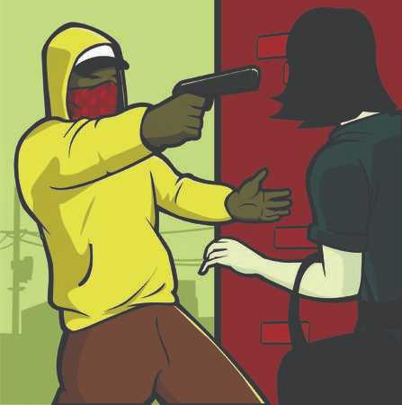
Street Crimes
offenses committed by ordinary people against other people or organizations, usually in public spaces.

Slide 7
Victimless Crimes
Also called crimes without complaint. A third category of offenses not included in major crime indexes.
When the perpetrator is not explicitly harming another person. While some claim acts like these are victimless, others argue that they actually do harm society. Prostitution may foster abuse toward women by clients or pimps. Drug use may increase the likelihood of employee absences.
Violations of law in which there are no obvious victims.
Includes illegal drug use, prostitution and gambling.
The term “victimless crime” is misleading, however. Perhaps it is more correct to say that people who commit such crimes are both offenders and victims.

Slide 8
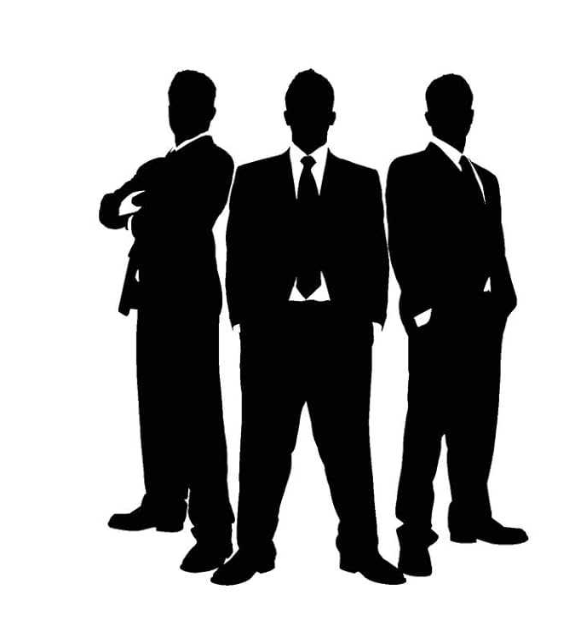
Corporate Crime

Slide 9
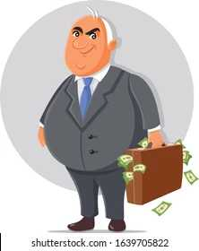
Corporate Crime
The illegal actions of a corporation or people acting on its behalf.
An often-overlooked category is corporate crime, or crime committed by white collar workers in a business environment.
Embezzlement, insider trading, and identity theft are all types of corporate crime.
Corporate crime includes whole companies engaging in illegal practices in pursuit of profit by any means necessary. Corporate crime ranges from knowingly selling faulty or dangerous products to deliberately polluting the environment (Derber, 2004).

Slide 10
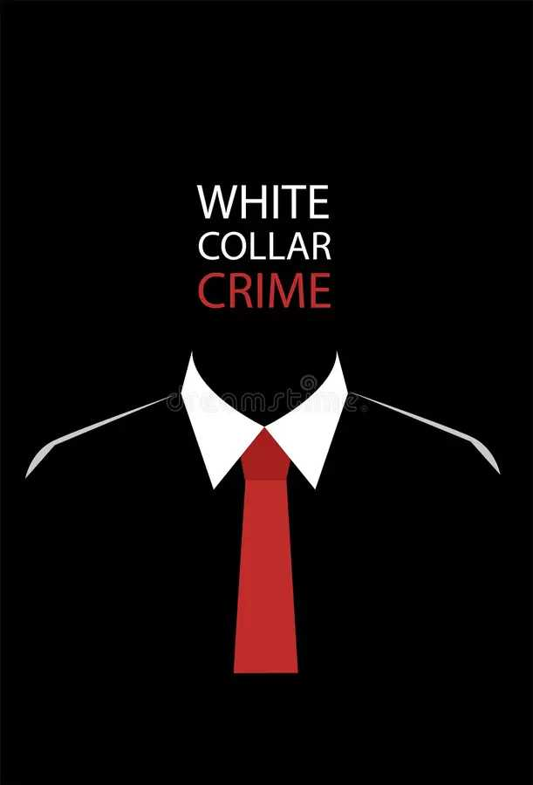
A non violent crime characterized by deceit to obtain or avoid losing money, or to gain a personal or business advantage.
Crime committed by people of high social position in the course of their occupations.
White collar crimes do not involve violence and rarely attract police to the scene with guns drawn. Rather, white collar criminals use their powerful offices to illegally enrich themselves and others, often causing significant public harm in the process.
For this reason, sociologists sometimes call white-collar offenses that occur in government offices and corporate boardrooms “crime in the suites” as opposed to “crime in the streets.”
The most common white-collar crimes are bank embezzlement, business fraud, bribery, and antitrust violations.

Slide 11
Types of White Collar Crimes
Fraud and False Statements
Tax Evasion
Money Laundering
Extortion
Embezzlement
Sutherland (1940) explains that such white-collar offenses typically end up in a civil hearing rather than a criminal courtroom. Civil law regulates business dealings between private parties, and criminal law defines the individual’s moral responsibilities to society. In practice, then, someone who loses a civil case pays for damage or injury but is not labeled a criminal.
Corporate officials are also protected by the fact that most charges of white-collar crime target the organization rather than individuals. When white-collar criminals are charged and convicted, they usually escape punishment.
A government study found that those convicted of fraud and punished with a fine ended up paying less than 10 percent of what they owed; most managed to hide or transfer their assets to avoid paying up. Among white-collar criminals convicted of the more serious crime of embezzlement, only about half ever served a day in jail.

Slide 12

Organized Crime
Organized crime is a business supplying illegal goods or services. Sometimes criminal organizations force people to do business with them, as when a gang extorts money from shopkeepers for “protection.” In most cases, however, organized crime involves the sale of illegal goods and services—often sex, drugs, and gambling—to willing buyers.
In the US the scope of its operations expanded among immigrants, who found that this society was not willing to share its opportunities with them. Today, organized crime involves a wide range of activities, from selling illegal drugs to prostitution to credit card fraud to selling false identification papers to illegal immigrants.

Slide 13
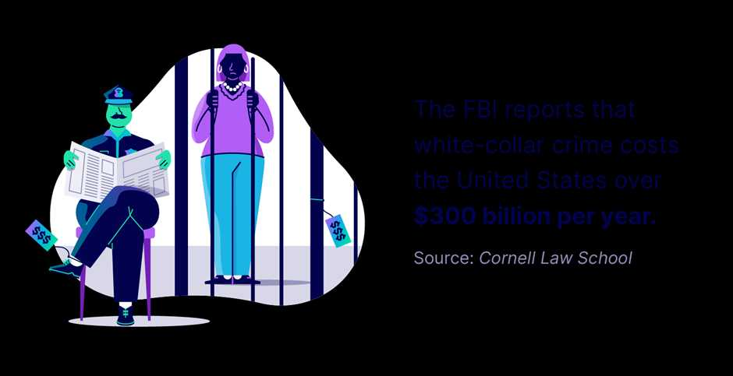

Slide 14
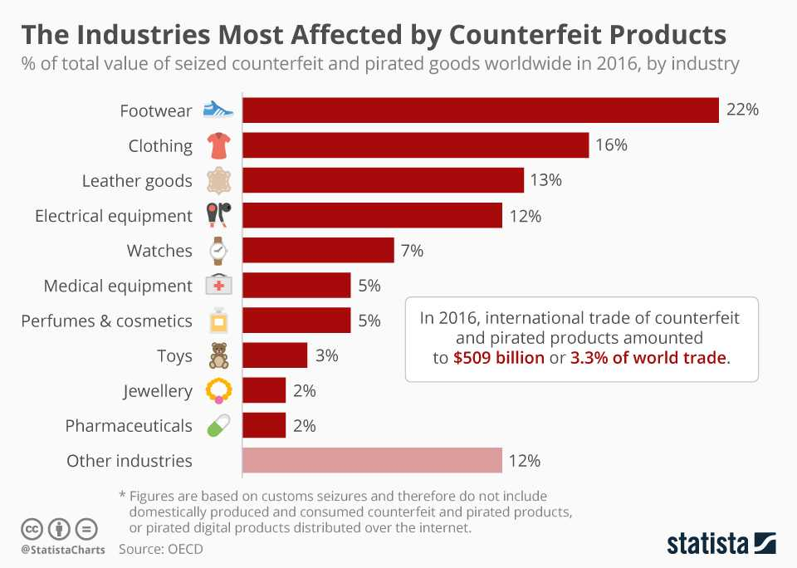

Slide 15
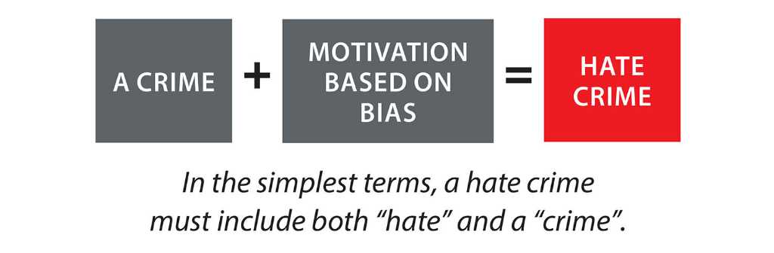
Race-Conflict Theory: Hate Crimes
A hate crime is a criminal act against a person or a person’s property by an offender motivated by racial or other bias.
A hate crime may express hostility toward someone’s race, religion, ethnicity or ancestry and, since 2009, sexual orientation, or physical disability.

Slide 16
The Medicalization of Deviance
The transformation of moral and legal deviance into a medical condition.
Medicalization amounts to swapping one set of labels for another. E.g., alcoholics as morally weak people. Gradually, however, medical specialists redefined alcoholism so that most people now consider it a disease, rendering people “sick” rather than “bad.” In the same way, obesity, drug addiction, child abuse, sexual promiscuity, and other behaviors that used to be strictly moral matters are widely defined today as illnesses for which people need help rather than punishment.
The Difference Labels Make - Whether deviance is a defined as a moral or a medical issue has three consequences. First, it affects who responds to deviance. An offense against common morality usually brings about a reaction from members of the community or the police. A medical label, however, places the situation under the control of clinical specialists, including counselors, psychiatrists, and physicians.
A second issue is how people respond to deviance. A moral approach defines deviants as offenders subject to punishment. Medically, however, they are patients who need treatment.
Third, the two labels differ on the personal competence of the deviant person. Once someone has been labelled as sick, they are seen as unable to control (or if “mentally ill,” even to understand) their actions. People who are labeled incompetent are in turn subjected to treatment, often against their will. For this reason alone, attempts to define deviance in medical terms should be made with extreme caution.

Slide 17
